Slide 1
VHDL Project
N-bit Multiplier and Divider
Presented By
Team 9

Slide 2
Team members:
Ahmed Ezzat
Nedaa Gaafer
Omnia Mohamed
Mohamed Hosam Othman Yassen

Slide 3
Work Division:
Sequential Multiplier and its testbench part Ahmed Ezzat
Sequential Divider and its testbench part Mohamed Hosam
Combinational Multiplier and its testbench part
Combinational Divider and its testbench part

Slide 4
2) Sequential Divider:
Generics:
N: integer generic with a default value of 4.
Input ports:
- a: input signal with N bits width, it’s the dividend part.
- b: input signal with N bits width, it’s the divisor part.
- clk: input clock port.
- RST: input asynchronous active low reset port.
- start: input 1 bit signal that is set for 1 clock cycle when the operands are firstly set to start the operation.
Output ports:
- m: output signal with N bits width, it’s the quotient part.
- r: output signal with N bits width, it’s the remainder part.
- error: output 1 bit signal that is set for 1 clock cycle when the divisor part has zero value.
- busy: output 1 bit signal that is set whenever the operation is on and stops when the operation is done.
- valid: output 1 bit signal that is set when the operation is done and the results appear.
Notes:
- a, b, m are signed signals, while r is of type std_logic_vector.
- We’ve chosen N to be equal to 4 to make it easy to get the 2’s complement of input signal in case of –ve signed numbers, while having enough bits to have wide enough numbers range.

Slide 5
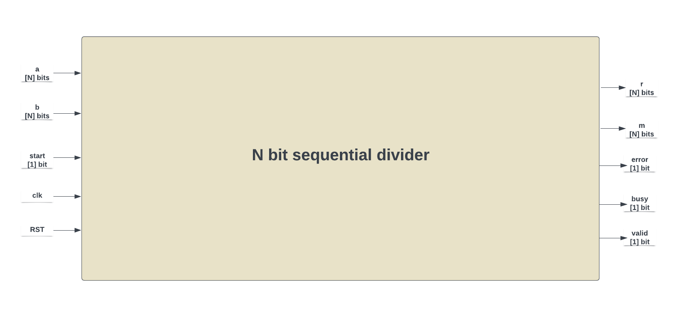
2) Sequential Divider:

Slide 6
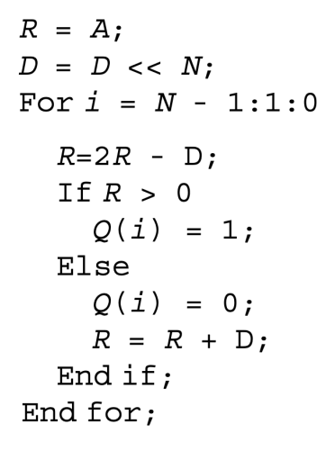
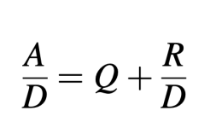
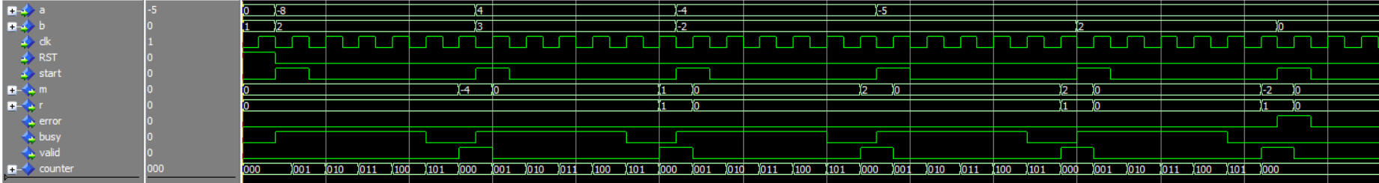
2) Sequential Divider:
Its architecture is based on an algorithm called: restoring division.
This algorithm depends on shifting, addition and
subtraction.
It consumes N+1 clock cycles to produce
the output.

Slide 7
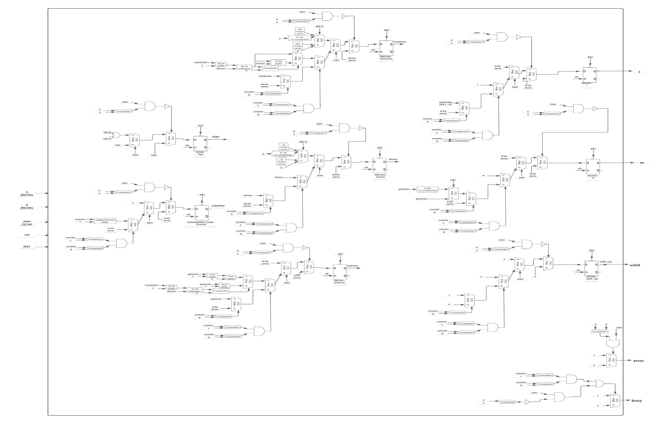
2) Sequential Divider:
The expected schematic (block diagram) of the architecture:

Slide 8
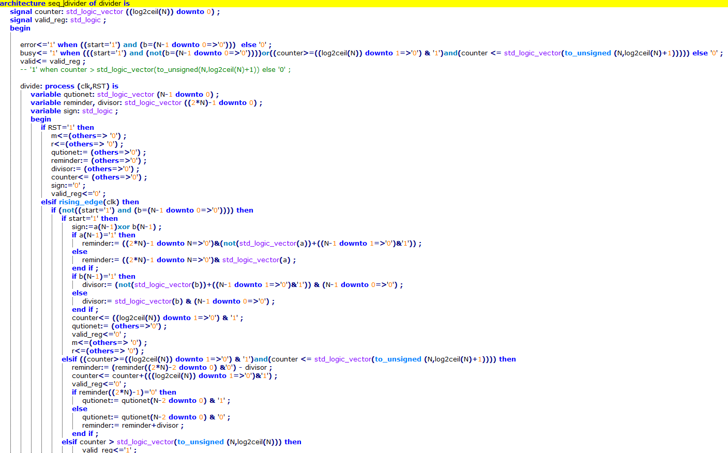
2) Sequential Divider:
A Screen of part of the VHDL code:

Slide 9
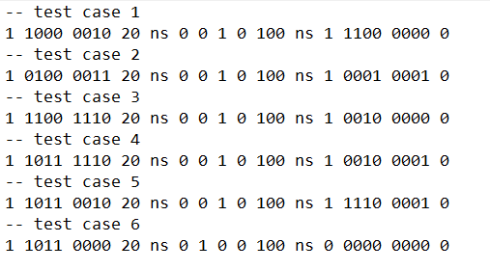
2) Sequential Divider:
In its testbench, we’ve 6 testcases which cover almost all cases to check that the divider works properly as intended.
The testcases are read from a text file as follows:
Each value corresponds to the following signals consecutively: start, a, b, pause (time variable for wait statement), start, error_expected, busy_expected, valid_expected, pause, valid_expected, m_expected, r_expected, busy_expected.

Slide 10
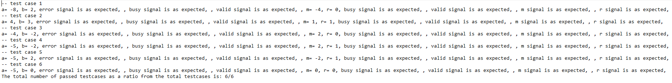
2) Sequential Divider:
The output of each testcase is written in a text file as follows:
Each testcase covers specific corner case as follows:
Testcase 1 tests dividing a negative number by a positive number with no remainder.
Testcase 2 tests dividing a positive number by a positive number with remainder.
Testcase 3 tests dividing a negative number by a negative number with no remainder.
Testcase 4 tests dividing a negative number by a negative number with a remainder.
Testcase 5 tests dividing a negative number by a positive number with a remainder.
Testcase 6 tests dividing a number by zero.
At the end, the total number of passed testcases as a ratio from the total testcases is printed.

Slide 11
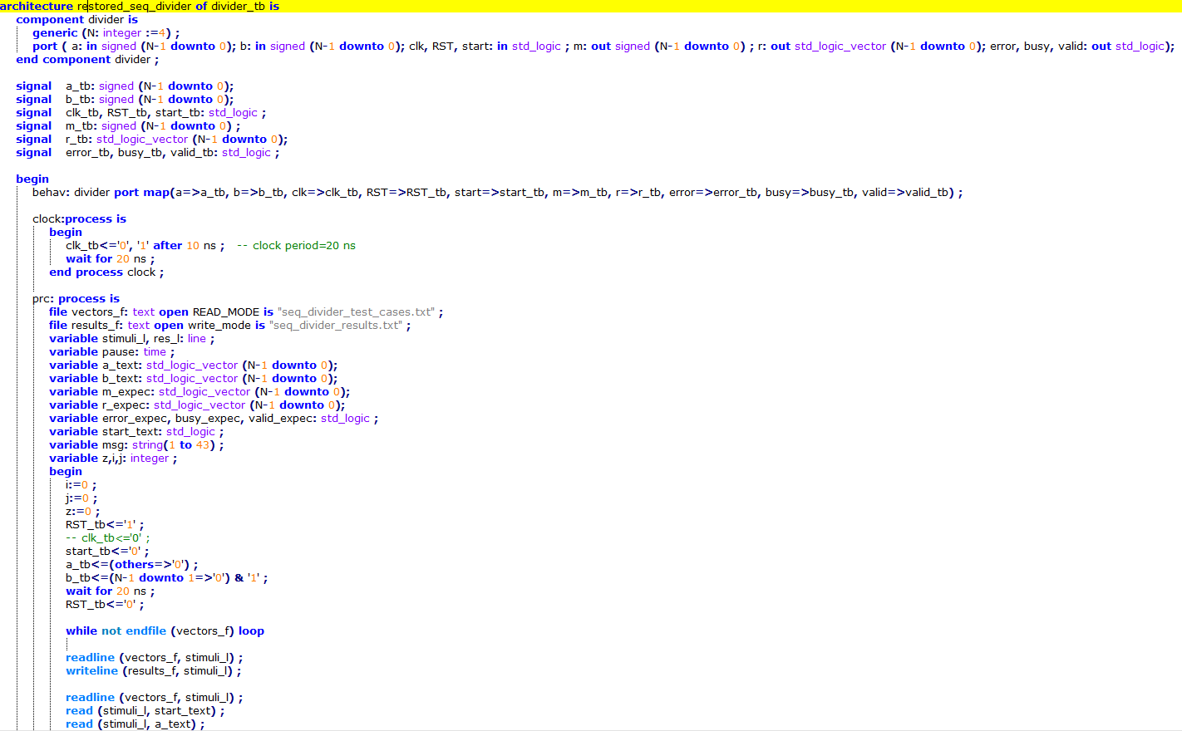
2) Sequential Divider:
The testbench compares the output signals with the expected ones and prints the result of this comparison in the results text file.
A screen of part of the testbench:

